Slide 1
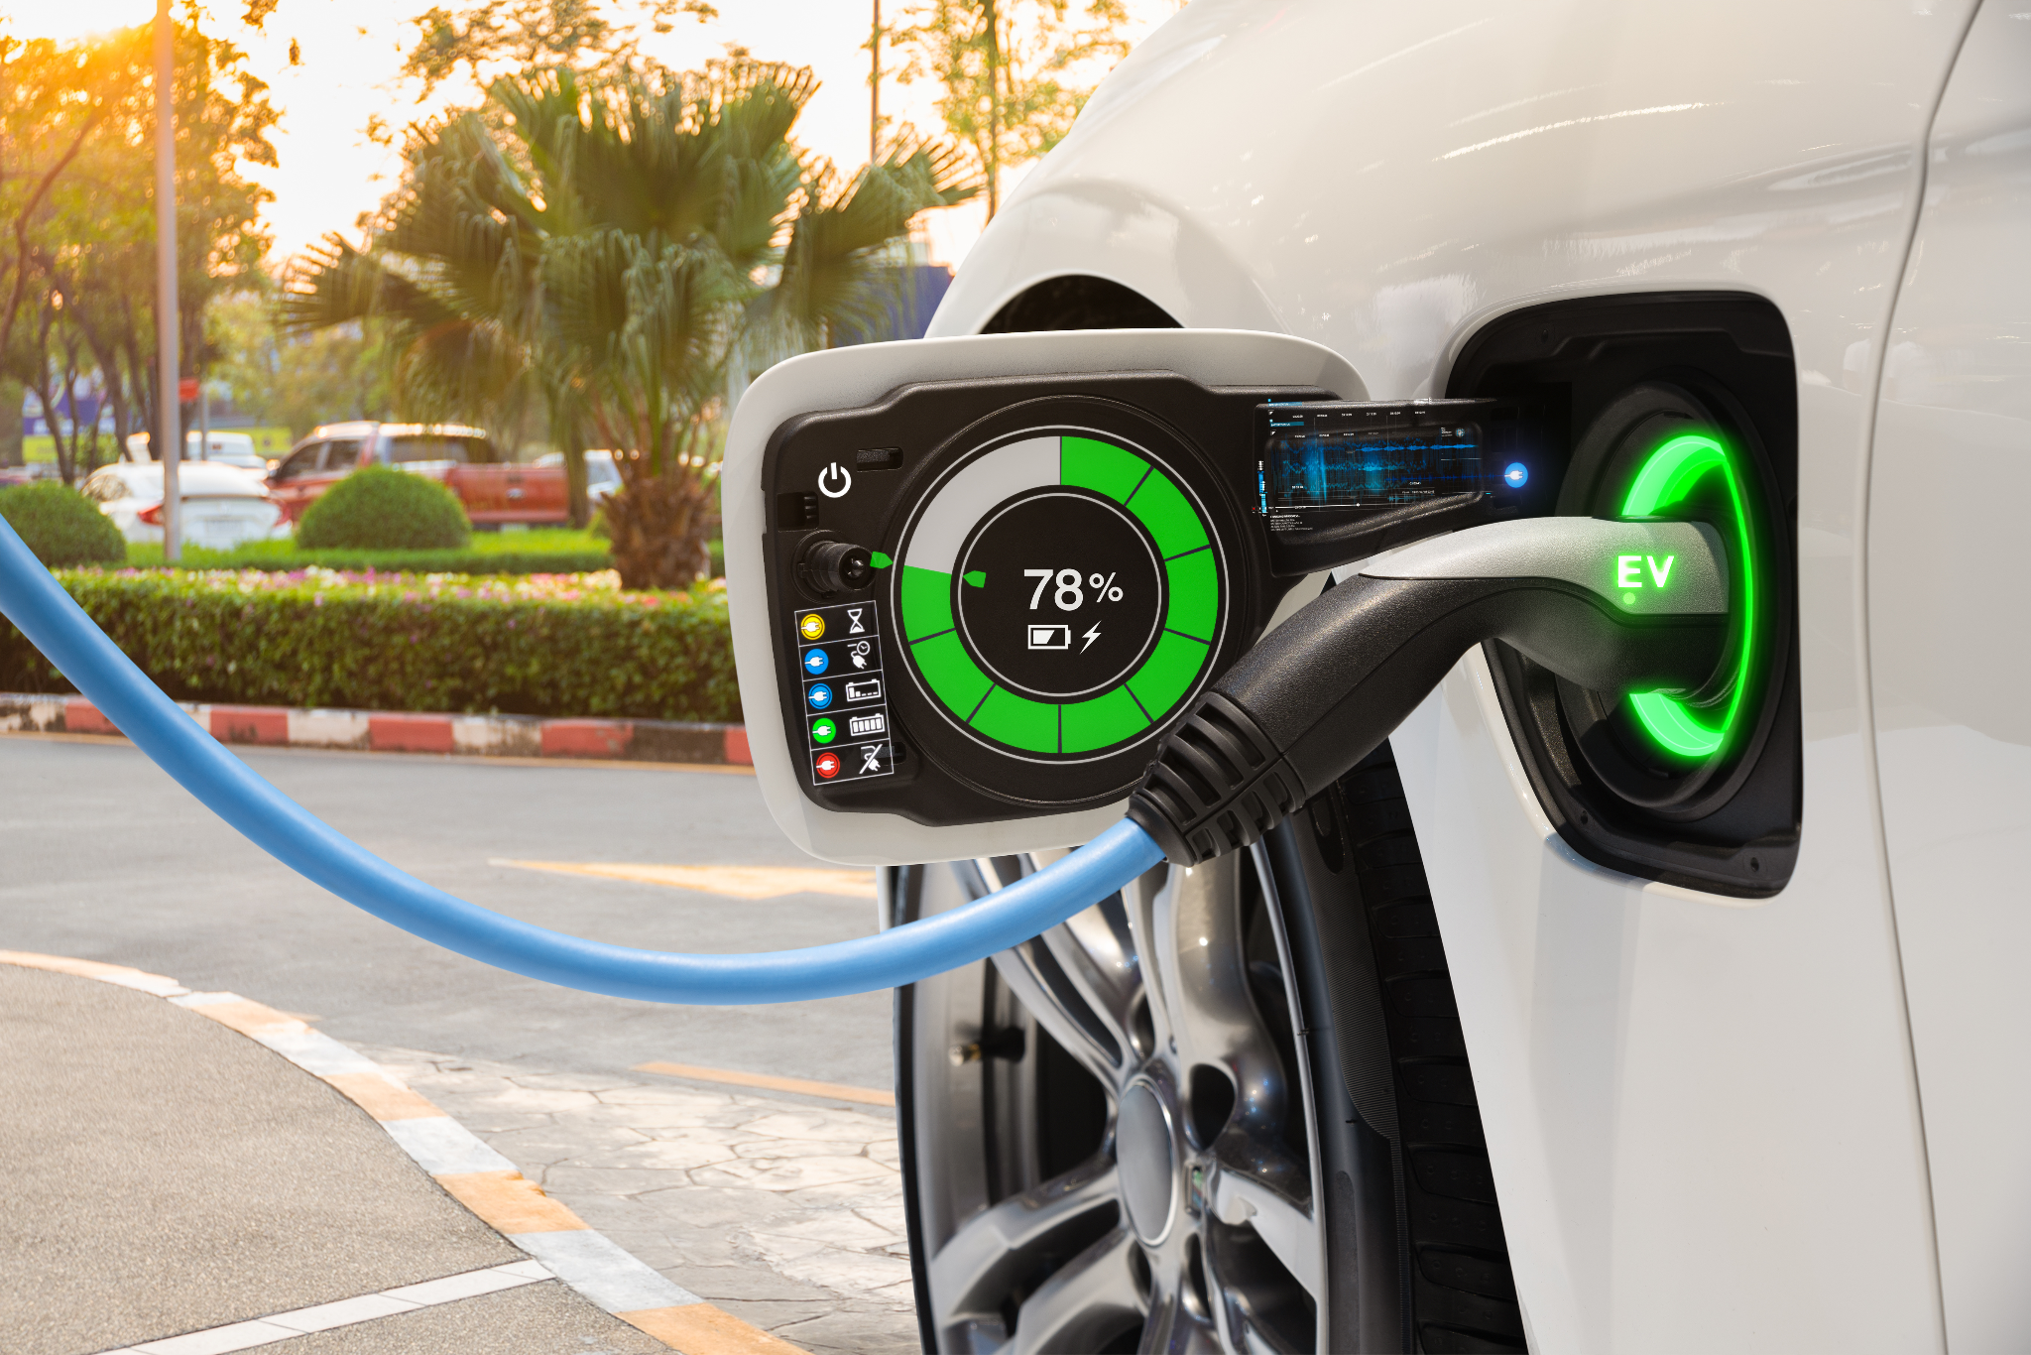
California EV Dreams
A comprehensive view of EV sales in the state of California

Slide 2
What factors contribute to sales in CA?
The purpose of this project is to analyze factors that contribute to EV purchases in the state of California. At a more granular level, we will be looking at factors within California counties to determine any relevant factors that contribute most to purchases.
With this analysis we would like to answer the following questions:
What is the opportunity in identifying a gap in this dataset?
What is the market opportunity?
Which counties in CA should EV manufacturers focus their marketing?
Should EV manufacturers be encouraging implementation of incentives to drive sales?

Slide 3
Tools & Technologies
After identifying the topic and collecting the datasets to support it, we next identified our tool set.
Establishing a clear communication tool using Slack and Google docs was of utmost importance in order to keep the flow of information going and progression forward.
Python 3.7.13 and Jupyter Notebook were used to clean, reshape and transform our data
Excel was the original format of our datasets
SQL was used to create our relational database and where we extracted our data into PG admin.
Tableau was our visual tool and what we used to create our visuals; incentives by county, sales by county and average commute of EV owners.
Google Slides we used as our primary tool for our dashboard.
HTML and CSS were both used in the building of our web application.

Slide 4
What is an EV?
An electric vehicle is a vehicle that runs fully or partially on electricity. Unlike conventional vehicles that just use fossil fuels, e-vehicles use an electric motor that is powered by a fuel cell or batteries. We can also use the terms ‘e-vehicle‘ and ‘EV.’*
* https://marketbusinessnews.com/financial-glossary/electric-vehicle/

Slide 5

Localizing trends in Global Market: What’s driving up EV sales
Global Trends
US markets Impacts
01.
EU growth (2019 – 2020) > US & everywhere else
West Coast EV uptake 2.7x more than national average
02.
Infrastructure investments ramping up in EU
Infrastructure investments & incentives to purchase EVs in planned via US Govt.
03.
Policy pressures – EU reduction in emissions and vehicles in cities
OEM strategies - model availability, production, sales targets
Policy pressures - CA, WA, CO ICE bans are coming.
04.
Corporate influence - EV company cars, values driven priorities impacting EV market
OEM: more models available, aggressive production and sales targets across
05.
06.
Consumer sentiment - price point, driving range, charging are key to adoption
Consumer sentiment - price point & driving range close to ICE
Notes:
State / By Year / Details
ICE Bans:
Washington / 2030 / All new vehicles sold must be zero emission
California / 2035 / All new vehicles sold must be zero emission
Colorado / 2050 / All new vehicles sold must be zero emission

Slide 6
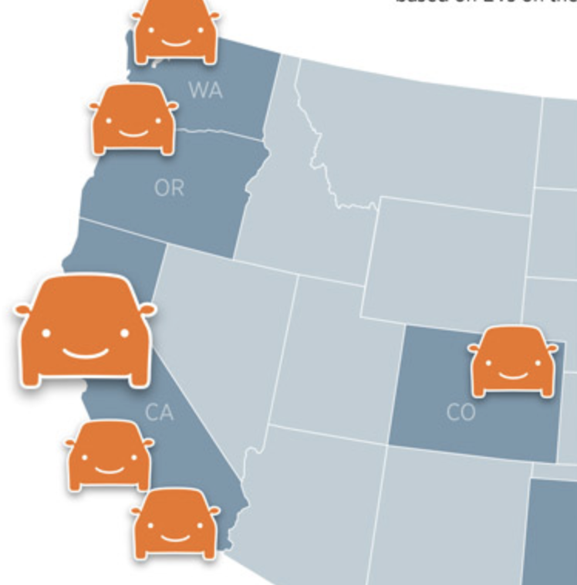
West Coast EV Adoption
Largest EV markets
West Coast EV adoption rates ~3x nat’l average
Southern California
Northern California
Seattle
Portland
EV adoption is set to grow
Many states are phasing out ICE vehicles
Investments in infrastructure and EV consumer incentives are growing
Price point and driving range are on par with ICE
*Internal Combustion Engine
Notes:
Just another reason West Coast is the Best Coast

Slide 7
Data Exploration
Identified topic to help guide the process of data exploration
Each of the group members took a set of data and owned that dataset.
Our data consisted of 3 datasets; demographics data for EV owners in CA, incentives by counties in CA, and sales data broken down by county, make and model.
One of the limitations in the data sets particularly in the incentives data was missing certain incentive start dates.
Another limitation of the data was potentially skewed data through COVID years related to consumers driving less and less consumption in general.
Multiple linear regression was performed on the demographics and the incentives by county data set.
Notes:
*Excluded COVID years and why
Include data sets and type of data found in research. What was removed from our data and what was kept?
Limitations of the data

Slide 8
Machine Learning Model
The initial reshaping of the data took place in Jupyter notebook. We read in each of the data sets, identified that there were several nulls that needed to be removed. In addition, we took a fraction of the data given that our demographics data set was large.
AWS Relational Database and PG Admin
After completion of the initial evaluation, cleaning and reshaping of the data, we created a relations database in AWS and connected it to our PG Admin account. This allowed us to join our datasets and start correlating our metadata.
Our Dependent variables were: Ownership/Sales
Our Independent variables were: Income, Incentives, Length of Commute, etc.
The final 3 highest correlated factors were determined by multiple linear regression analysis.
Notes:
-Challenges/ how we overcame them
-tools used

Slide 9
Demographic makeup
Notes:
-Correlation factors of linear regression ( ie commute, household income vs sales)
-Demographics doesn’t contain the county, explain further.

Slide 10
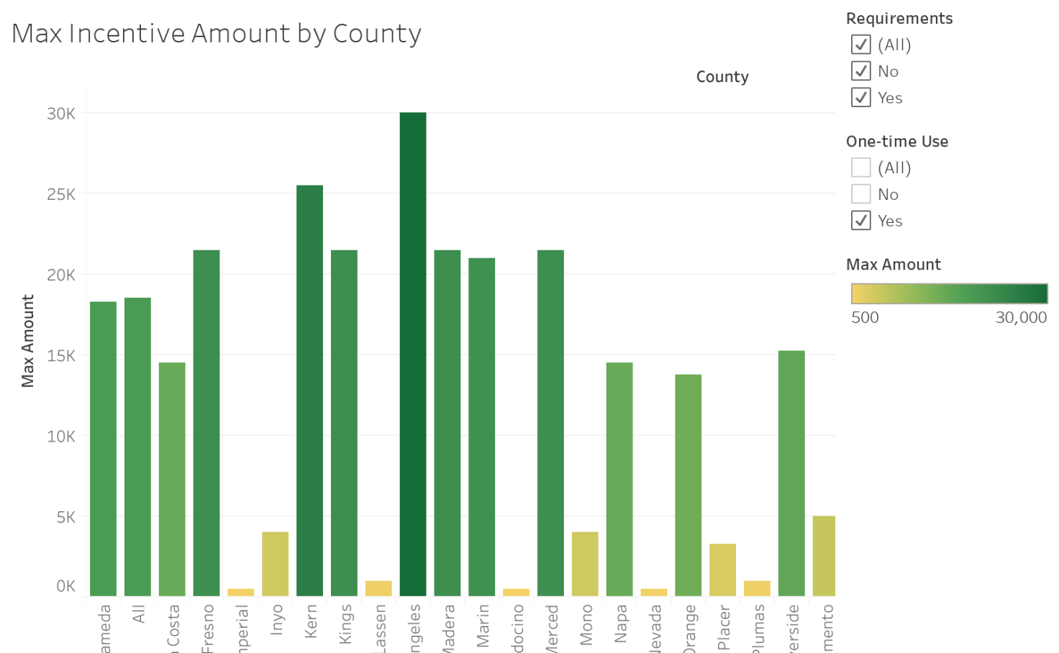
Incentives by Counties
The following bar graph illustrates the max incentives broken down by county in the state of California.
By far we can see Los Angeles county tops the chart offering up to 30K in total incentives*.
*Certain incentives require meeting several requirements in order to be eligible.

Slide 11
Conclusions
What did we learn?
What are the three takeaways from this project? That can be backed up with data.
Notes:
Answers to questions
Potential opps
What else?
Future investigations; given more time what would we have done more of?

Slide 12
Future Opportunities
Potential limitations of our data; our database for demographics doesn’t contain county thus limits shared data with other databases.
Potential opportunities for manufacturers of EV vehicles could be as simple as awareness of incentives to counties with a lower EV purchase rate particularly in smaller populated counties.
Potential opportunity; does ethnic/racial diversity matter and/or contribute to EV sales?
What about age? Should manufactures target market a younger demographic group by building a customer centric approach to their marketing?
How much money does a typical EV owner save in fuel cost?
What type of EV has higher sales and what are the factors that contribute to a higher sales margin?

